Slide 1

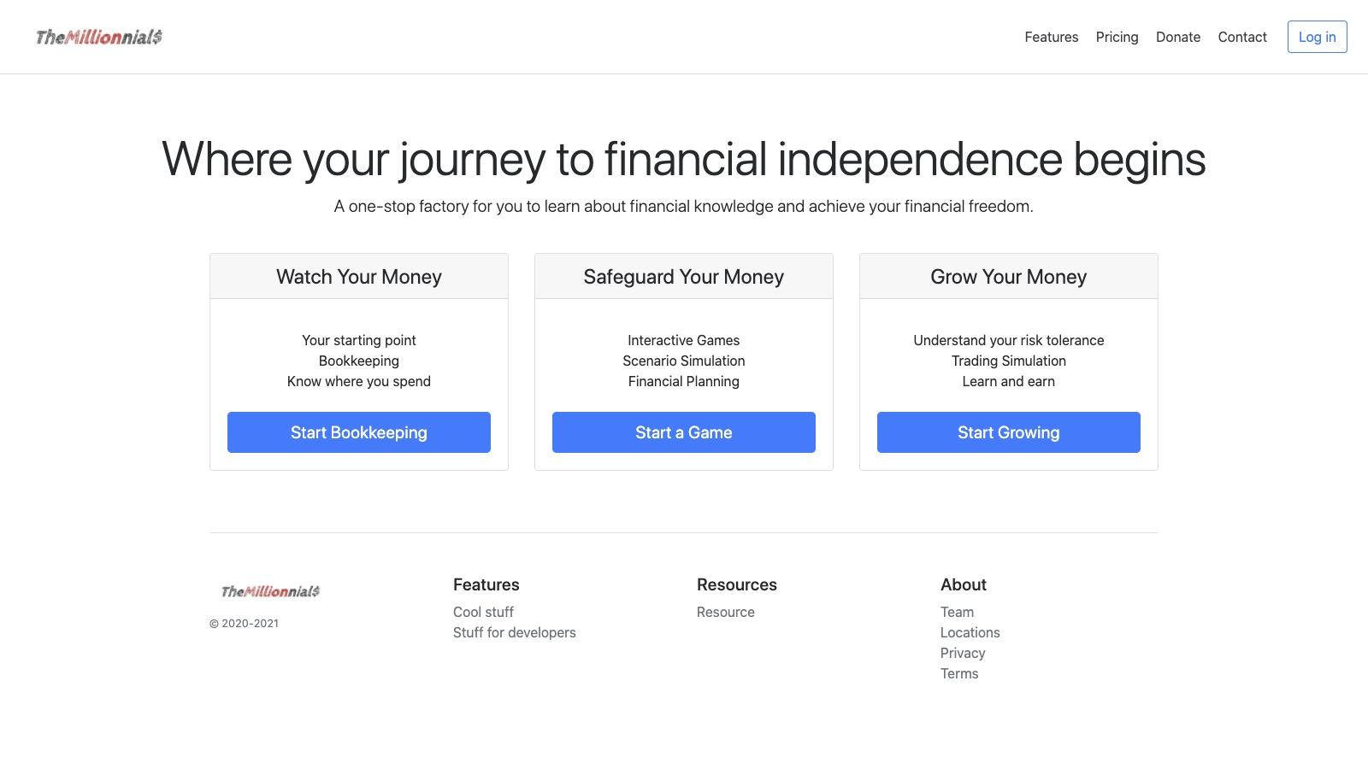


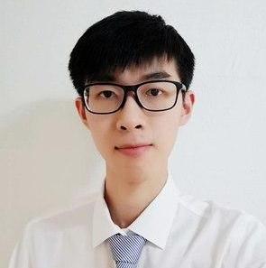


Make Dreams Happen for Millennials
By Team TNT
Bu Wende
Jiang Hanyu
Qi Haodi
Zhang Chengzi
Wang Xuze
7 September 2020

Slide 2
Problem Analysis
Reason
Traits
COntext
Survey: 2 in 3 young people have not started investing (Koh, 2016).
61% lacking financial knowledge.
59% Insufficient money to invest.
Tend to be short-term investors -> prefer equity
Low investment amount
→ limited finance product choice
→ prefer high risk products
Economies impacted
by Covid-19
Decrease in salaries
More likely to save
More time spent virtually

Slide 3
Target group analysis
01
DEMOGRAPHICS
02
motivation
03
behaviour
Age between 18 -30
Students & young working adults
Received tertiary education
Focus on short-term tangible goals (e.g. gadgets)
Plan for next stage of life (e.g. BTO for marriage)
Short attention span
Heavy social media users
Emphasis on visual aesthetics

Slide 4
Our Solution
Watch Your Money
Bookkeeping
Spending behaviour analysis
Safeguard Your Money
The Millionnials
Long-term investment planning
Scenario-based games
The first Web Application for Millennials to gain financial knowledge through scenario-based games and trading simulation in Singapore.
Grow Your Money
Risk Profiling
Short-term goal setting
Trading simulation with real-time market data

Slide 5
Appeal to preferences of young people
01
GAMIFICATION
02 Tangible goals
03 Easy sharing
Learning through games piques the interests of young people
Setting tangible goals drives higher motivation for investments
One click sharing of reports of achievement on social media

Slide 6
Why do youngsters use it?
Facilitate effective learning
04
Visualization
05
Relevance
06 Simulation
Use of various charts for better analysis & insights
Effective facilitation of financial knowledge acquisition
Singapore context
(e.g. BTO and Tuition Loan) is incorporated in the scenario-based games.
Trading simulation with real time market data allows users to try trading without the fear of monetary losses

Slide 7


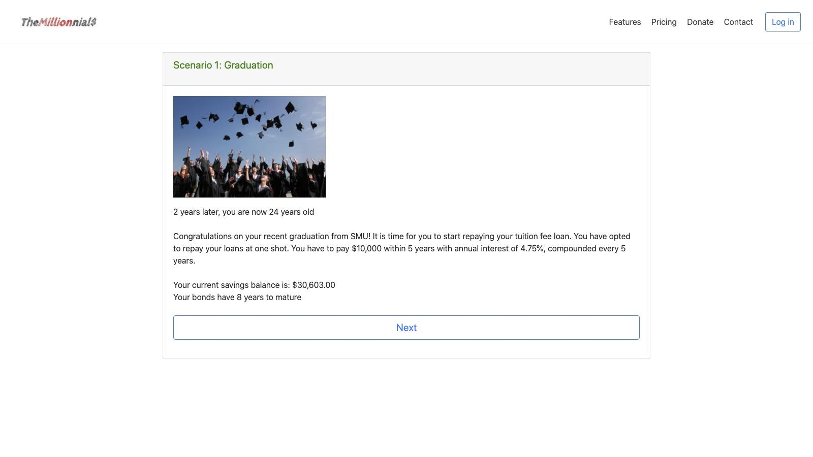
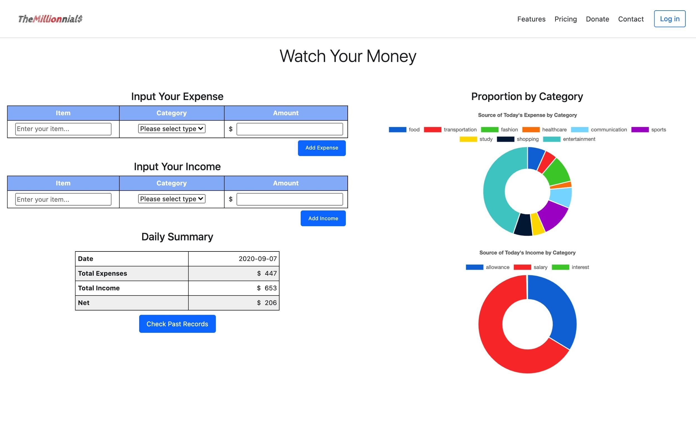
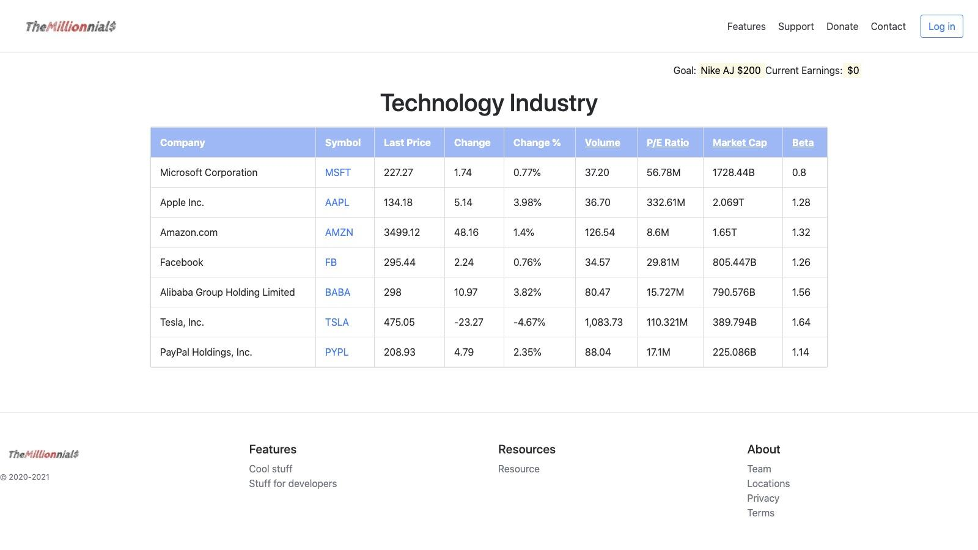
Use case
Alice Young, 22, is a graduate student from SMU. She is going to work at Goldman Sachs for a monthly salary of $5000. She has taken up a tuition fee loan of $30,000 and she plans to BTO soon with her boyfriend. However, she has little financial knowledge to begin with...
Journey Begins here...
Safeguard Your Money
Grow Your Money
Watch Your Money

Slide 8








Current Solution Architecture
EC2
Landing Page
Watch your money
MySQL DB
Client Web Server
Save your money
Grow your money
Marketstack API

Slide 9
Future plan
01
Scalability
02 More Features
03
Resilience
Web application will be able to scale up on demand for greater traffic flow
Greater variety of features and more financial products will be added
To better serve the young people today
Stronger resilience and higher availability with more sophisticated architecture

Slide 10





To-be Solution Architecture
Region
Auto-scaling group in Availability Zone 2
Client Web Server
Auto-scaling group in Availability Zone 1
Web App with LAMP
Landing Page
Watch your money
Elastic Load Balancer
AWS RDS
Save your money
Grow your money
Facebook API
Twitter API
Marketstack API

